Slide 1
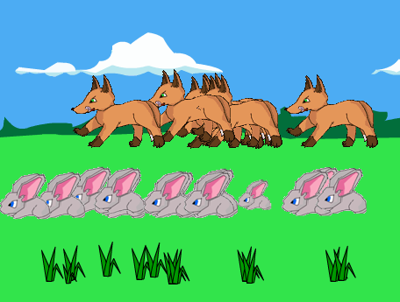
Sunny Meadows Predictions

Slide 2
The Game
Sunny Meadows is a simulation game that allows you to choose the sizes of three populations: grass, rabbits, and foxes. Then, you watch the populations interact for 50 years. At the end of 50 years, you will be able to see how the biomass in each population has changed. Before you play the game, make some predictions about what you think will happen during the game.

Slide 3
What initial population sizes will produce the largest fox biomass?

Slide 4
What initial population sizes will produce the largest overall biomass?

Slide 5
What initial population sizes will produce the most O₂ and the most CO₂ in the atmosphere?

